Slide 1
Efficient Binary Search Trees
10-<number>

Slide 2
BST: Searching Algorithm
tree_pointer itersearch(tree_pointer tree, int key)
{
while (tree) {
if (key == tree->data) return tree;
if (key < tree->data)
tree = tree->left_child;
else tree = tree->right_child;
}
return NULL;
}
CHAPTER 5

Slide 3
Two Binary Search Trees (BST)
1
1
10
10
2
2
2
2
5
25
5
20
3
3
3
20
15
25
4
15
For each identifier with equal searching probability , average # of comparisons for a successful search:
  Left: (1+2+2+3+4)/5 = 2.4
  Right: (1+2+2+3+3)/5 = 2.2
prob(5, 10, 15, 20, 25) = (0.3, 0.3, 0.05, 0.05, 0.3)
  Left :0.3×(2+1+2)+0.05×(4+3) = 1.85
  Right: 0.3×(2+1+3)+0.05×(3+2) = 2.05
10-<number>

Slide 4
Extended Binary Trees
Add external nodes to the original binary search tree
  Take external nodes as failure nodes .
External / internal path length
  Internal path length, I, is:
  I = 0 + 1 + 1 + 2 + 3 = 7
  External path length, E, is :
  E = 2 + 2 + 4 + 4 + 3 + 2 = 17
E = I + 2n, where n is # of internal nodes.
0
10
1
1
5
25
2
2
2
2
20
3
3
15
4
4
10-<number>

Slide 5
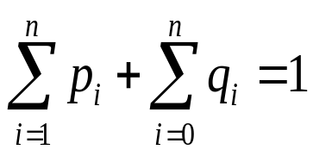
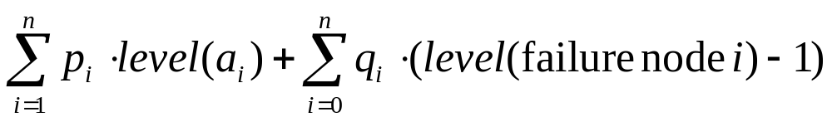
Search Cost in a BST
In the binary search tree( BST):
  Identifiers a₁, a₂, …, a_{n} with a₁ < a₂ < … < a_{n}
  p_{i} :probability of successful search for a_{i}
  q_{i} : probability of unsuccessful search a_{i} < x < a_{i+1}
Total cost
An optimal binary search tree for a₁, …, a_{n} is the one that minimizes the total cost.
1
10
2
2
5
25
3
3
3
3
20
4
4
15
5
5
10-<number>

Slide 6
Search Cost in a BST
Consider the possible binary search trees for the key set (a1, a2, a3)= (5,10,15). Find the optimal binary search tree
  with equal probabilities, pi = qi = 1/17 for all i and j
  with p1=0.5, p2=0.1, p3=0.05, q0=0.15, q1=0.1, q2=0.05, q3=0.05
  Ans: i. (15/17……13/17)
  ii. (2.65, 1.9, 1.5, 2.05,1.6)
10-<number>

Slide 7
Red-Black Trees
A red-black tree is an extended binary search tree.
Each node/pointer (edge) is colored by red or black.
  Colored nodes definition
  Colored edges definition
6
4
9
2
5
8
11
Internal nodes
1
3
7
10
12
External nodes
Extended binary search tree
10-<number>

Slide 8
Colored Node Definition
Colored node definition
  RB1: The root and all external nodes are black.
  RB2: No root-to-external-node path has two consecutive
  red nodes.
  RB3: All root-to-external-node paths have the same number of black nodes.
65
50
80
10
60
70
5
62
10-<number>

Slide 9
Colored Pointer (Edge) Definition
Colored pointer (edge) definition
  RB1’: Pointer to an external node is black.
  RB2’: No root-to-external-node path has two consecutive red pointers (edges).
  RB3’: All root-to-external-node paths have the same number of black pointers.
65
50
80
10
60
70
5
62
10-<number>

Slide 10
Length and Rank in a Red-Black Tree
Let the length of a root-to-external-node path be the number of pointers (edges) on the path.
Let the rank of a node be the number of black pointers (edges) (equivalently the number of black nodes minus 1) on any path from the node to any external node in its subtree.
Lemma: P, Q: two root-to-external-node paths
length(P) ≤ 2 * length (Q)
10-<number>

Slide 11
Properties of a Red-Black Tree
Lemma: Let h be the height of a red-black tree (excluding the external nodes), let n be the number of internal nodes, and let r be the rank of the root.
    (a) h ≤ 2r
    (b) n ≥ 2^{r}−1
    (c) h ≤ 2 log₂(n+1)
10-<number>

Slide 12
Why Red-Black Tree
Most of the BST operations (e.g., search, max, min, insert, delete.. etc) depends upon h,where h is the height of the BST.
For a skewed Binary tree….. n
If we make sure that height of the tree remains log(n) after every insertion and deletion, then we can guarantee an upper bound of log(n) for all these operations.
The height of a Red-Black tree is always log(n) where n is the number of nodes in the tree.
10-<number>

Slide 13
How does Red-Black Tree ensure balance?
A chain of 3 nodes is nodes is not possible in Red-Black Trees.
Following are NOT Red-Black Trees
30 30 30
/ \ / \ / \
20 NIL 20 NIL 20 NIL
/ \ / \ / \
10 NIL 10 NIL 10 NIL
Violates Violates Violates
Property 4. Property 4 Property 3
Following are different possible Red-Black Trees with above 3 keys
20 20
/ \ / \
10 30 10 30
/ \ / \ / \ / \
NIL NIL NIL NIL NIL NIL NIL NIL
10-<number>

Slide 14
Red-Black Tree
Representation
  External nodes: null pointers
  Pointer / node color:
    One / two additional bit(s) per node
Search
  Same as ordinary binary search tree
10-<number>

